Slide 1
Data Miners
Zahra Hatami
Sowjanya Joga
Praseeda Sasanka Pisipati

Slide 2
Agenda
About Data
Research Questions
Data Relevance to Target Audience
Analysis & Interpretations
Derived Decisions

Slide 3
About data – Excess deaths and causes
This data set helps us in evaluating the cause of deaths in various states and increase the health consciousness among the people.
Represents the following number of deaths in different states in the United States
(1) Expected deaths
(2) Observed deaths
(3) Potentially Excess deaths
Data collected based on five leading causes of death in metropolitan and non-metropolitan areas
(1) Heart disease
(2) Cancer
(3) Unintentional injury
(4) Chronic lower respiratory disease
(5) Stroke

Slide 4
About data – Excess deaths and causes
Target Audience for this data set are:
Doctors
Health Researchers’ Groups
Medicine Companies
Limitations
Only has the data for age ranges less than 85
Only deals with five-leading causes of death

Slide 5
Meta Data
State FIPS Code were numeric and two-letter alphabetic codes defined in U.S. Federal Information Processing Standard Publication (“FIPS PUB”)
Mortality data for U.S. residents come from the National Vital Statistics System
Cause of death is based on the International Classification of Diseases, 10th Revision (ICD-10)
Locality (nonmetropolitan vs. metropolitan) is based on the Office of Management and Budget’s 2013 county-based classification scheme.
Benchmarks are based on the three states with the lowest age and cause-specific mortality rates.
HHS Region is the number of the region allocated by the Office of Intergovernmental and External Affairs. It hosts ten Regional Offices that directly serve state and local organizations. A President-appointed Regional Director leads each office.
Potentially excess deaths for each state are calculated by subtracting deaths at the benchmark rates (expected deaths) from observed deaths.

Slide 6
Research Questions
What is the trend of observed deaths for all five-leading cause of deaths over time?
What is the trend of expected deaths, observed deaths, potentially excess deaths in each age group?
Compare the number of deaths for various regions of US. Which region has the maximum and minimum number of deaths recorded for the years 2005 to 2015?
Compare the number of deaths for each locality. Which locality has the maximum and minimum number of deaths recorded for the years 2005 to 2015?
What is the ratio between the observed deaths and the Population? What is the trend of the ratio over time by region?
What is the ratio between the expected deaths and the Population? What is the trend of the ratio over time by region?
Are the ratios in questions 5 and 6 correlated?

Slide 7
Data Relevance To Target Audience
Identify the deaths pattern in metropolitan or non-metropolitan areas
Identify in which age group are the most deaths observed
Identify the leading cause for death in each age group
Increase the health consciousness among public
Motivate public to practice a healthy lifestyle
Doctors and Health Research Groups can educate public through the community health programs
Medicine Companies can plan an effective strategy for sales of medicines

Slide 8
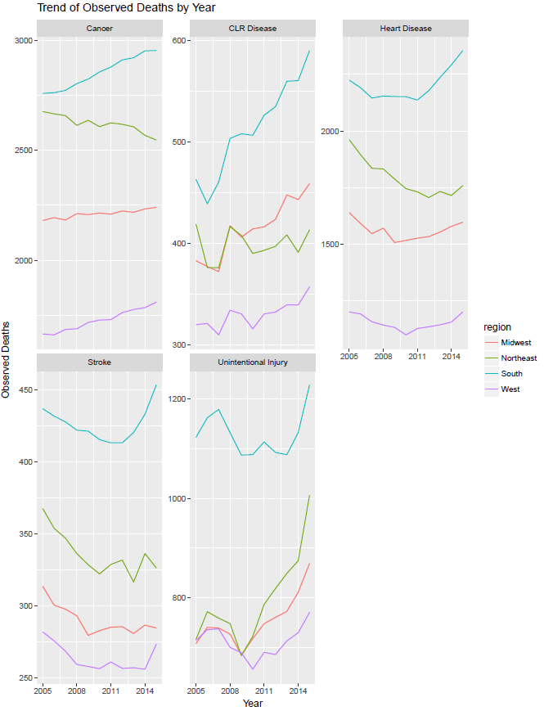
Analysis & Interpretation
Cancer has the highest number of observed deaths as per below trend. It is the only cause of death which didn’t show any deviation in its trend. All the other causes recorded a decrease and an increase. And the Southern region has the highest number of deaths recorded in cancer category

Slide 9
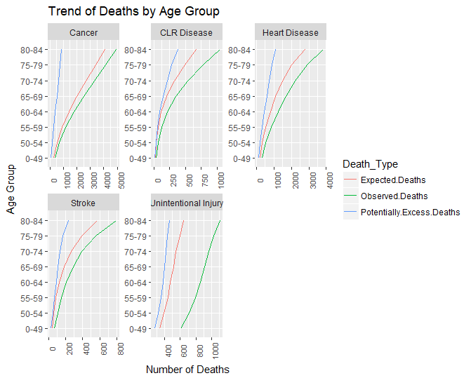
Trend of Deaths by Age Group
The number of observed deaths always exceeded the expected deaths. And also the age and number of deaths are proportional to each other i.e as the age increases, so did the number of deaths.

Slide 10
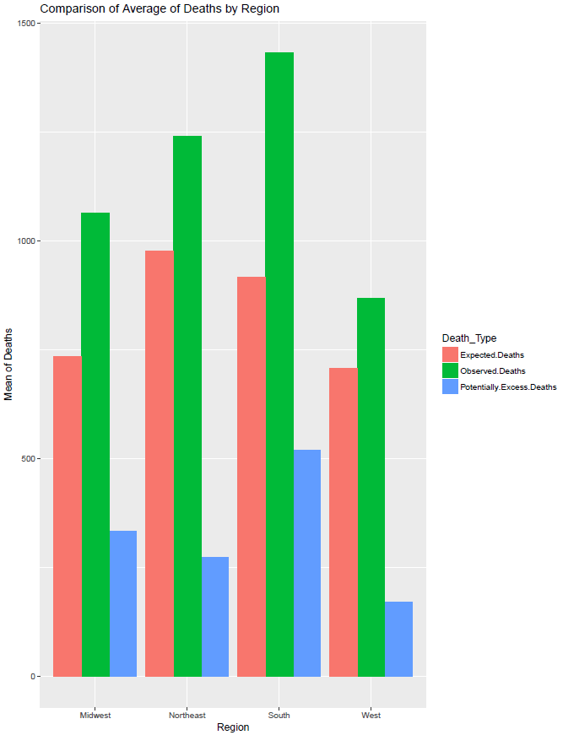
Comparison of Average of Deaths by Region
Observed deaths are more in the southern part of the United States followed by Northeast, Midwest and West. The Expected Deaths average is almost equal in both South and Northeast. South region also has the maximum average for potentially excess deaths followed by Midwest, Northeast and West

Slide 11
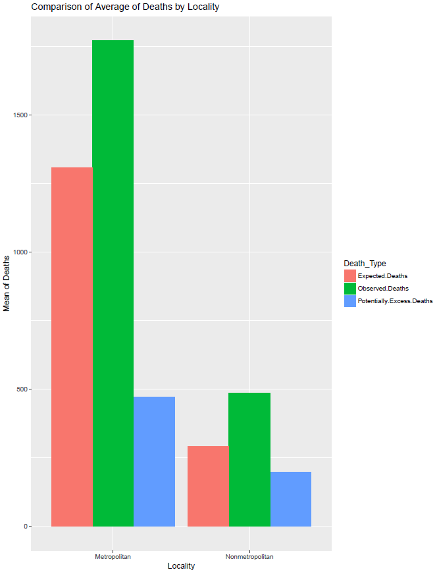
Comparison of Average of Deaths by Locality
Considering the population in metropolitan area, it is obvious that the number of deaths recorded in metropolitan would be more than non-metropolitan. But from the data we derived that most number of deaths are recorded in non-metropolitan than the metropolitan area when considering the regions and age group separately for each locality

Slide 12
Derived Decisions
The increase in number of deaths due to cancer can be due to more tobacco use in non-metropolitan areas. Steps and necessary programs need to be conducted to reduce the tobacco use
This increase can also be due to less physical activity or due to less travel options for health care and checkups. Doctors and Government need to consider options to improve physical activity and also increase the availability of health care services to public.
Conduct various research programs to cure the diseases in the initial stages as and when detected
The uneven trends in all the four-leading cause of deaths except cancer should be carefully examined. If the decrease in death rate is due to any events or programs during that year, a plan should be made to conduct such programs in South and North East regions of US, which recorded the highest number of deaths

Slide 13
Derived Decisions
The southern states have higher obesity rates when compared to other regions. It also recorded stroke as the major cause for the deaths. The South East regions recorded more in-patient stays in 2012. The South West and Atlantic South are in fifth and seventh position.
Region | States
South East | Alabama, Kentucky, Mississippi, Tennessee
South Atlantic | District of Columbia, Delaware, Florida, Georgia, Maryland, North Carolina, South Carolina, Virginia, West Virginia
South West | Arkansas, Louisiana, Oklahoma, Texas
North East- New England | Connecticut, Massachusetts, Maine, New Hampshire, Rhode Island, Vermont
North East- Middle Atlantic | New Jersey, New York, Pennsylvania

Slide 14
THANK You
Any Questions ?

